Slide 1
OS Admin
Processes - Linux

Slide 2
Module objectives
After completing this module you will be able to:
Describe what a process is
Explain how Linux handles processes
Use tools to get information about processes
Use tools to start, stop & terminate processes
Identify zombie & orphan processes

Slide 3
Controlling Processes
Overview Of Processes
Information about Processes
Starting & Stopping Processes
Parents & Children
Zombies & Orphans

Slide 4
What is a process?
Linux like any operating system is a collection of smaller programs
Each program provides some of the operating system’s functionality
A process is an instance of a program running or a program in execution.
Applications running in Linux can consist of one or more processes. They can be started by the system (i.e. Daemons) or started by the user (i.e. Jobs).
In order to do work they utilise memory and CPU.
They need to be managed - if they stop working properly they can use up all the memory and CPU cycles on the system and cause it to slow down.

Slide 5
Threads
A thread is the smallest schedulable stream of instructions to be processed by the CPU.
A CPU core divides its time up between different threads.
Typically a single core of a CPU can only deal with 1 thread at a time.
The CPU core constantly switches from thread to thread to give the appearance of multi-tasking. This is called ‘Time Slicing on the CPU’.
Processes can be made up of 1 or more threads.

Slide 6
Why control Processes?
Every process uses resources from RAM and CPU.
Most of the time processes only use what they need and release resources once they’ve finished with them.
Occasionally a process fails to release resources and may end up hogging a large proportion of the RAM or CPU.

Slide 7
The Process Table
The process table contains details of all processes currently running on the system.
It is used to decide where system resources such as RAM or CPU are allocated.
When a process terminates it should be removed from the process table to free up RAM and CPU resources for other processes.

Slide 8
Process control in Linux
Linux includes many tools for working with processes.
In the rest of this module we’ll look at tools for:
  Getting details of processes.
  Starting & stopping processes.
  Dealing with zombie & orphan processes.

Slide 9
Controlling Processes
Overview of Processes
Information about Processes
Starting & Stopping Processes
Parents & Children
Zombies & Orphans

Slide 10
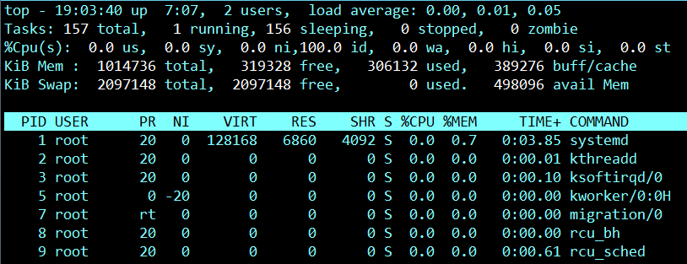
Listing Processes
The top command can be used to real-time detailed list of all processes currently running.
It is very similar to the processes tab of the Task Manager in Windows.
Notes:
This first line indicates in order:
current time (19:03:40)
uptime of the machine (up 7:07)
users sessions logged in (2 users)
average load on the system (load average: 0.00, 0.01, 0.05) the 3 values refer to the last minute, five minutes and 15 minutes.
The second row gives the following information:
Processes running in totals (157total)
Processes running (1 running)
Processes sleeping (156 sleeping)
Processes stopped (0 stopped)
No. of Zombies (0 zombie)
The third line indicates how the cpu is used. If you sum up all the percentages the total will be 100% of the cpu. Let’s see what these values indicate in order:
Percentage of the CPU for user processes (0.0%us)
Percentage of the CPU for system processes (0.0%sy)
Percentage of the CPU processes with priority upgrade nice (0.0%ni)
Percentage of the CPU not used (100%id)
Percentage of the CPU processes waiting for I/O operations(0.0%wa)
Percentage of the CPU serving hardware interrupts (0.0% hi — Hardware IRQ
Percentage of the CPU serving software interrupts (0.0% si — Software Interrupts
The amount of CPU ‘stolen’ from this virtual machine by the hypervisor for other tasks (such as running another virtual machine) this will be 0 on desktop and server without Virtual machine. (0.0%st — Steal Time)
The fourth and fifth rows respectively indicate the use of physical memory (RAM) and swap. In this order: Total memory in use, free, buffers cached.

Slide 11
What top lists
PID – A unique number identifying each process.
USER – The user running the process.
PR – The priority of the process.
NI – Used in priority computation.
VIRT – How much virtual memory the process is using.
RES – How much RAM the process is using.
SHR – Shared memory of the process
S – Indicates the status of the process: S=sleep R=running Z=zombie
%CPU – The percentage of CPU used by this process
%MEM – The percentage of RAM used by the process
TIME+ – The total time of activity of this process
COMMAND – The name of the process
Notes:
Virtual memory is a memory management capability of an OS that allows a computer to compensate for physical memory shortages and run more concurrent applications by temporarily transferring inactive processes from random access memory (RAM) to disk storage while keeping the active ones in the RAM, and switch them whenever their status changes which is called Swapping.

Slide 12
Options for top
To sort the output of the top command:
top –o <resource>
Example:
To sort by memory usage:
top –o %MEM
To sort by CPU usage:
top –o %CPU

Slide 13
Listing processes using ps
The ps command can also be used for listing processes.
ps has several options:
  ps shows processes associated with the current logon
  ps –e shows all processes
  ps –ef shows details of all processes
  ps –u <UID> shows processes associated with a specific user

Slide 14
ps Example
How do you see which processes are running?
[trainee@unix ~]$ ps
[administrator@ip-10-0-8-115 ~]$ ps
PID TTY TIME CMD
11210 pts/27 00:00:00 bash
11238 pts/27 00:00:00 ps
[administrator@ip-10-0-8-115 ~]$
Unique ID
Command
Notes:
On execution of the command a process was spawned, the command was executed and on this occasion the result has been outputted to standard out (stdout)
The 4 headings are
PID – The unique process id
TTY - Terminal associated with the process
TIME - Total CPU usage
CMD – The command
Note! The processes displayed in this output are the only active ones for this user.

Slide 15
Key
The 4 headings are
PID – The unique process id
TTY – Terminal associated with the process
TIME – Total CPU usage
CMD – The command

Slide 16
Finding the PID for a process
Many commands for controlling processes require that you know the PID of the process.
Use the following command to find the PID:
  pgrep <process name>
  Example: pgrep crond

Slide 17
Process Trees
Processes can start other processes which in turn can start additional processes. This is known as a process tree.
A process which starts another process is called the parent process.
A process which is started by another process is called the child process.
A problem with a process may actually be caused by one of its child processes.

Slide 18
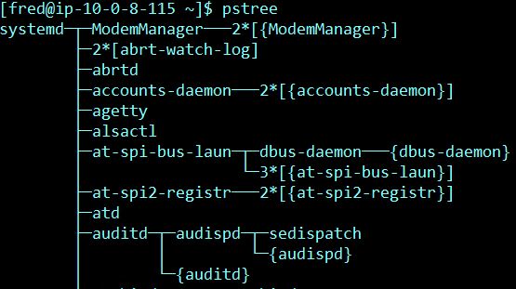
Displaying a process tree
Use the pstree command to display the process tree:
  pstree lists all processes and their process trees.
  pstree <PID> shows the process tree for a specific process

Slide 19

Finding arguments
Processes can run with different arguments. (e.g. ls can run with arguments l, R, i etc).
The arguments passed into a process may be what’s causing the process to have problems.
Use the ps –fp command to find the arguments that a process is using:

Slide 20
Controlling Processes
Overview of Processes
Information about Processes
Starting & Stopping Processes
Parents & Children
Zombies & Orphans

Slide 21
Stopping or Terminating a Process
Terminating a process.
  The process stops completely.
  When you restart the process it starts from scratch.
  Do this when a process is hanging or is behaving badly.
Stopping a process.
  The process is paused and waits to be restarted.
  When you restart the process it starts from where it was when it was paused.
  Do this when you’re troubleshooting a problem or when you need to do a task which requires that a particular process is not running.

Slide 22
How to terminate a process
Use the kill command to terminate a process.
kill [signal] <PID>
kill –l displays all the signal that we can use
  Example: kill 1234 or kill -9 1234
Or use pkill to terminate a process by name
Example: pkill sleep

Slide 23
How to pause a process
Use the kill –stop command to pause a process.
kill –stop <PID>
  Example: kill -stop 1234
Use the kill –cont command to restart a paused process.
kill –cont <PID>
  Example: kill -cont 1234

Slide 24
Controlling Processes
Overview of Processes
Information about Processes
Starting & Stopping Processes
Parents & Children
Zombies & Orphans

Slide 25
Process Diagram
Program.exe
Thread of
execution
Parent – Parent id
Fork – Create the sub process
Exec – Give the sub process
a job
Sleep
Child – Child id
Return – Returns a result
Exit – Returns an exit status
Wakes up
Parent – Parent id
Finish

Slide 26
Parents and Children
When a job starts it creates an original process called ‘The Parent’.
If the job is complicated the parent sub-divides the job into simpler tasks.
It then creates (i.e. Forks) one or more sub-processes, called children, and then gives each of them one of the simpler tasks, called execing.

Slide 27
Parents and Children (continued)
When the children have finished they return a result and an exit status back to the parent.
The exit status tells the parent if the child was able to perform the task or not.
The child is then supposed to disappear (i.e. be killed).
The parent then finishes it’s execution and returns a result back to the user.

Slide 28
Controlling Processes
Overview of Processes
Information about Processes
Starting & Stopping Processes
Parents & Children
Zombies & Orphans

Slide 29
Zombie Processes
When a child process finishes running it sends its exit status to its parent
The parent then removes (reaps) the child’s record from the process table
If the parent fails to remove the child’s process from the process table then the child becomes a zombie
A zombie process is dead but still shows up in the process table

Slide 30
How to find a zombie process
To see any zombie processes use the top command:
This will list all processes in the process table. Zombies will look like the output below:
6110 nick 1452K 880K Z 59 0 0:00:00 0.0% sh

Slide 31
Removing a zombie process
Zombie processes are already dead, so there’s no point in trying to kill them – it won’t help.
Instead we can send a notification signal to the parent process to take care of the dead child.
kill –chld <PID>
  Example: kill –chld 1234
The parent process ID

Slide 32
Orphan Processes
An orphan process is a child process that continues to run after it’s parent process has terminated.
When a process is orphaned it automatically becomes a child of the init process. Init has a PID of 1.
Unlike zombie processes, orphan processes can be terminated using kill.

Slide 33
Orphan Processes
Program.exe
Thread of
execution
Parent – Parent id
Fork – Create the sub process
Exec – Give the sub process
a job
Dies
Child – Child id
Adopted by init PPid = 1
Exit – Returns an exit status
Init – id = 1
PPid = Parent Process id

Slide 34
Exercise 4 – Processes
UNIX OS Admin Exercises
Notes:
Please refer to the MS OS Admin Exercises 2017 document on the LMS

